Slide 1
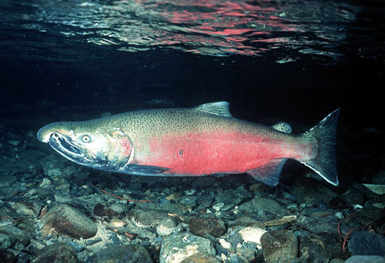
Biotic
describes living factors in the environment
Abiotic
describes the nonliving part of the environment, including water, rocks, light, and temperature

Slide 2
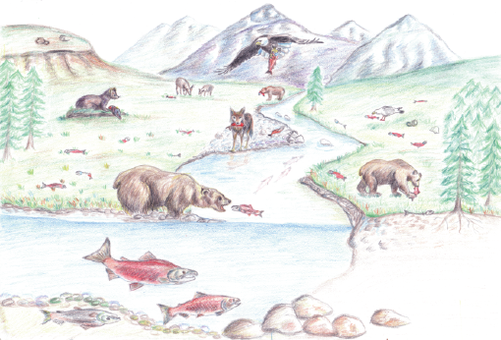
Community
a group of various species that live in the same habitat and interact with each other
Ecosystem
a community of organisms and their abiotic environment
Habitat
the place where an organism usually lives

Slide 3
A young salmon lives in the Zigzag river on Mount Hood. In that rocky-bottomed river, there are also aquatic insects, trout, crawdads, bacteria, algae and thousands of other living organisms.
*Name the salmon’s habitat.
*List five parts of the salmon’s community.
*List two biotic parts of the ecosystem.
*List two abiotic parts of the ecosystem.

Slide 4
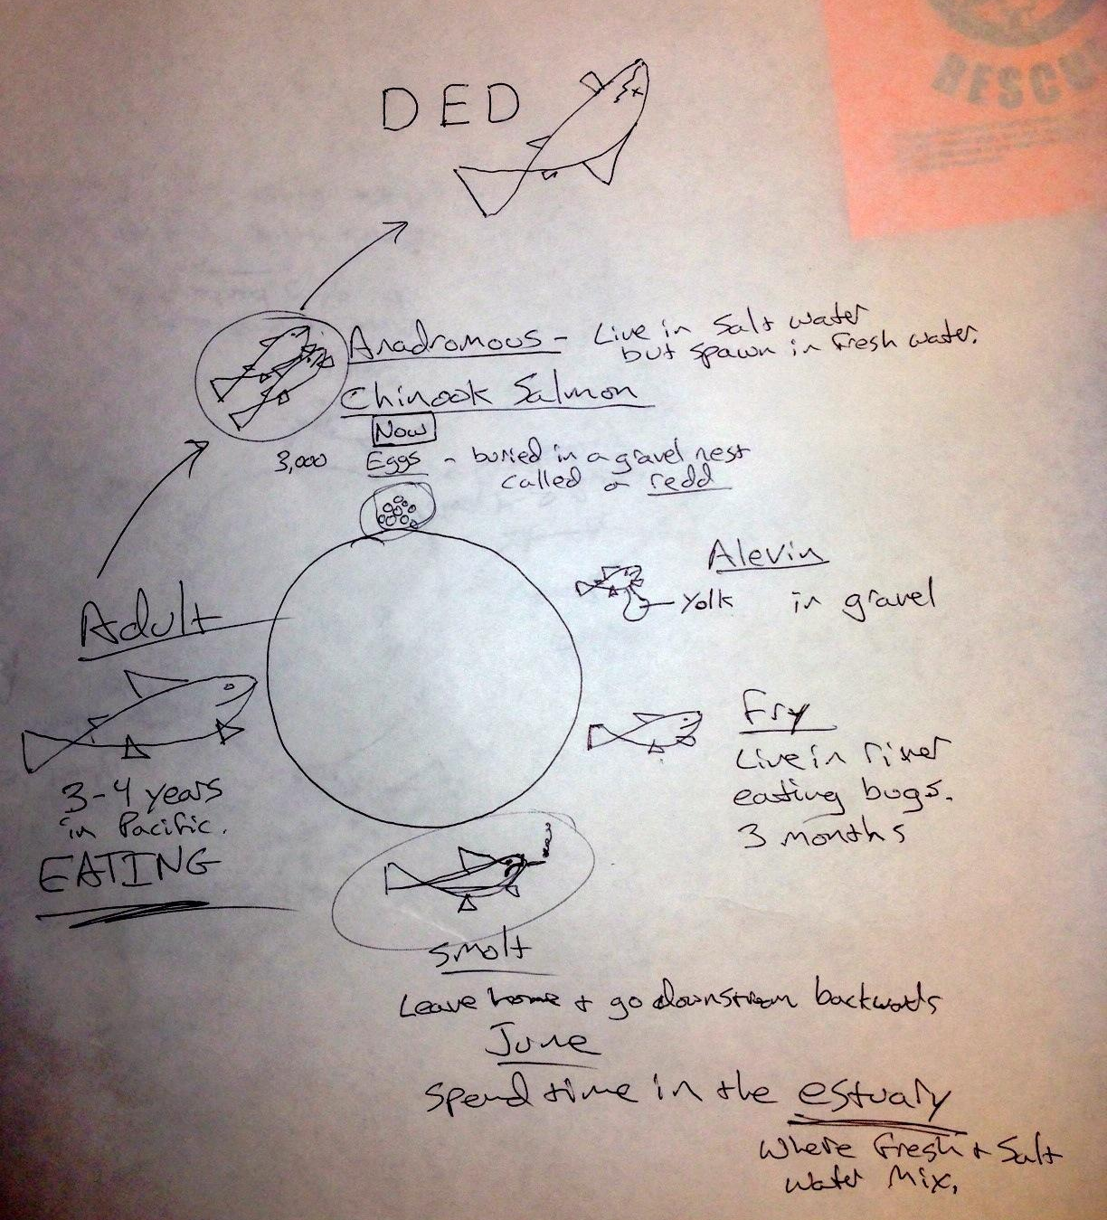
Salmon Life Cycle

Slide 5
Steps in a food chain
Producer
an organism that produces its own food (plants, algae and some bacteria)
Consumer
an organism that eats other organisms or organic matter (animals and many protists)

Slide 6
Steps in a food chain
Decomposer
an organism that feeds by breaking down organic matter from dead organisms (bacteria and fungi)
Trophic level
a step in a food chain or energy pyramid

Slide 7
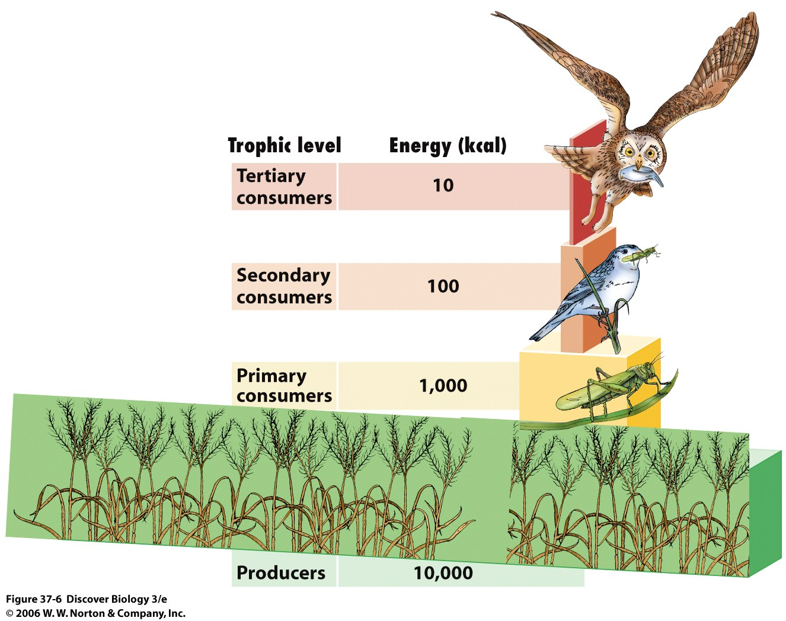
Energy Pyramid
On average, only 10% of an organism’s energy transfers to the next trophic level.
All energy is eventually lost as heat.
Energy is measured in Calories. Sound familiar?

Slide 8
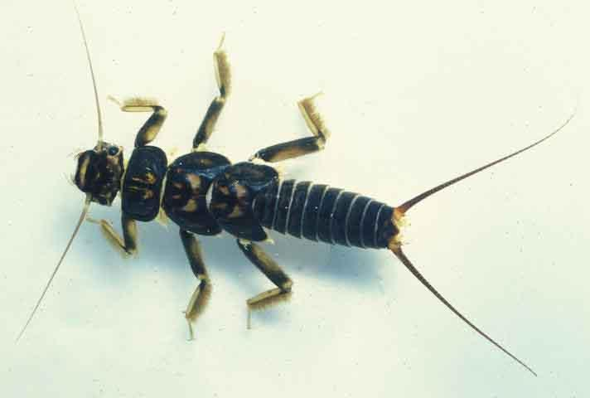
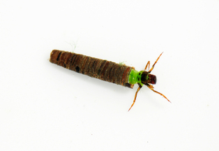
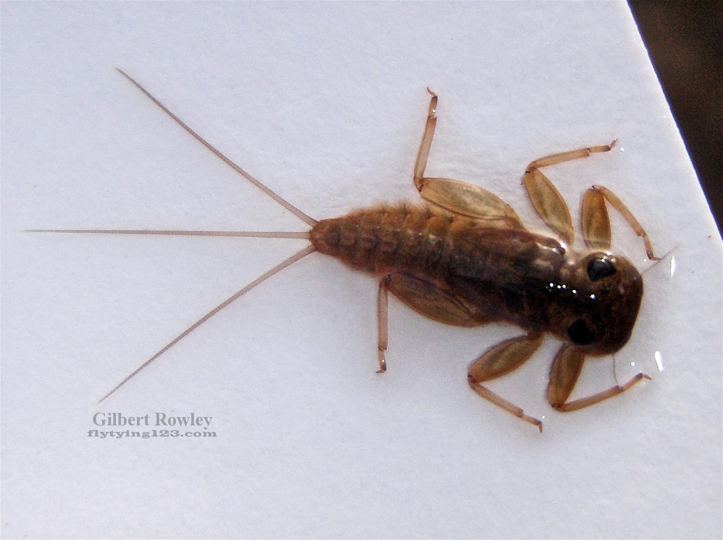
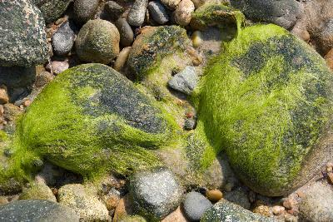
Stonefly nymph
Caddisfly larva
Mayfly nymph
This caddisfly eat leaves that fall into the river.
This mayfly scrapes algae off the rocks.
This stonefly eats other insects.
Who is a producer?
Who is a consumer?
algae

Slide 9
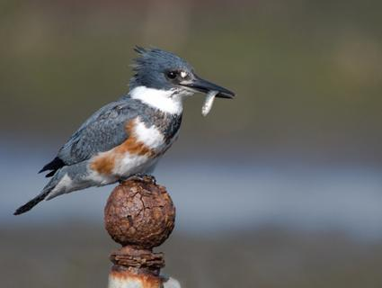
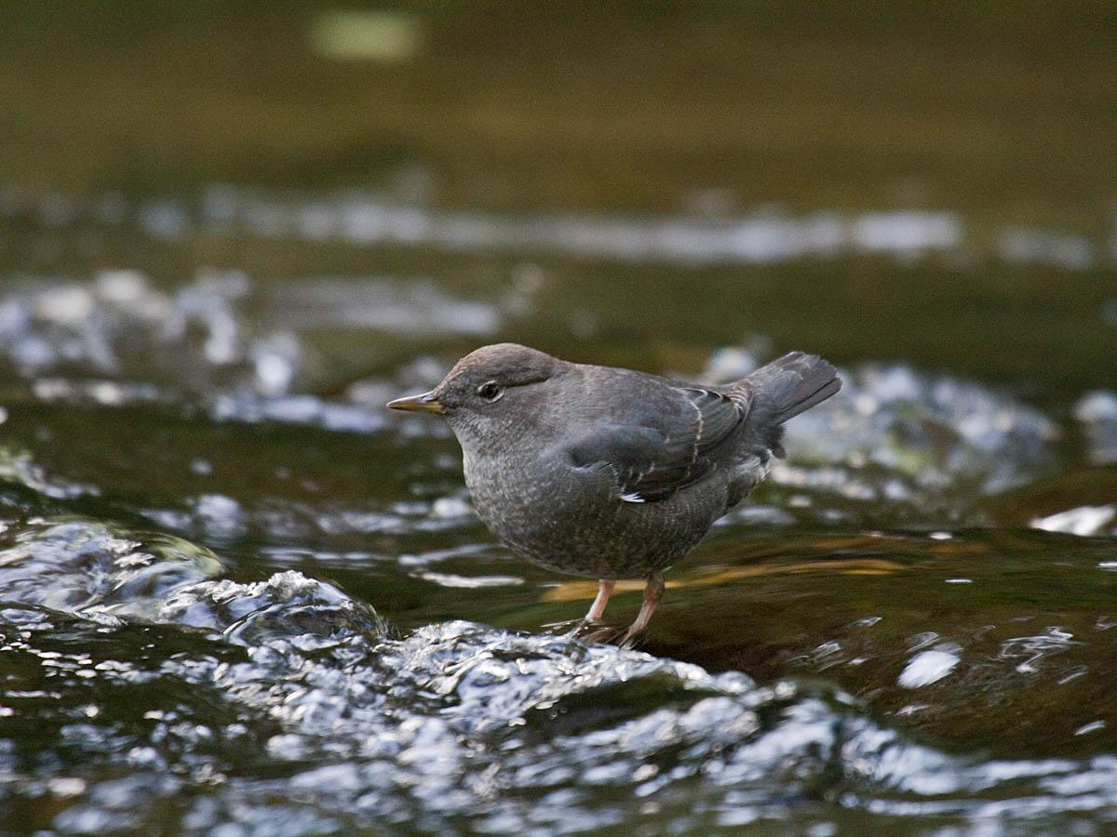
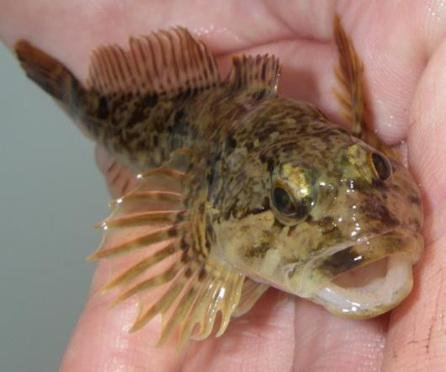
Kingfisher
Dipper
The kingfisher eats salmon fry and sculpins.
The dipper eats all aquatic insects.
The sculpins eat aquatic insects and salmon fry.
Salmon fry eat aquatic insects.
*Draw a food web for the organisms you have just learned about.
*Make an energy pyramid that starts with 5,000 calories of algae using six of the seven organisms.
Sculpin

Slide 10
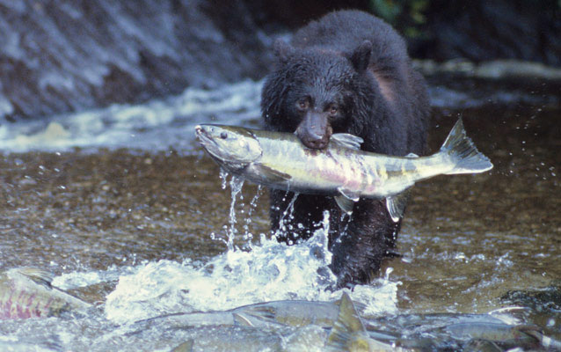
Cycling of Matter

Slide 11
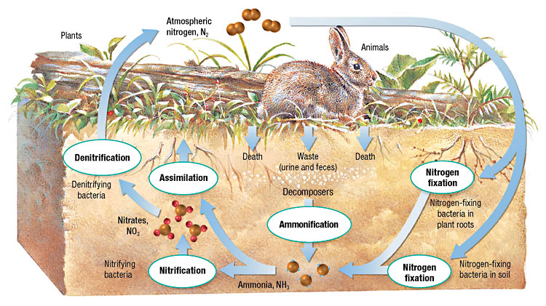
Nitrogen Cycle
Nitrogen gas (N₂) is 78% of the air we breathe but is unavailable to plants.
Most Nitrogen cycles between soil bacteria, plants and animals.
Nitrogen Fixing Bacteria (and industrial fertilizer factories) convert it to Ammonia (NH₃) which plants can use.

Slide 12
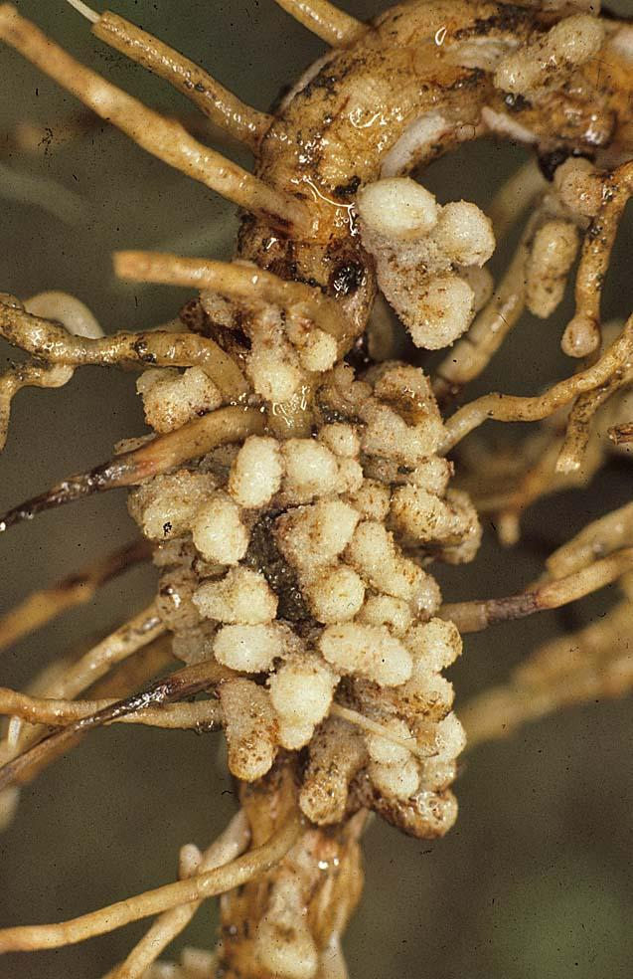
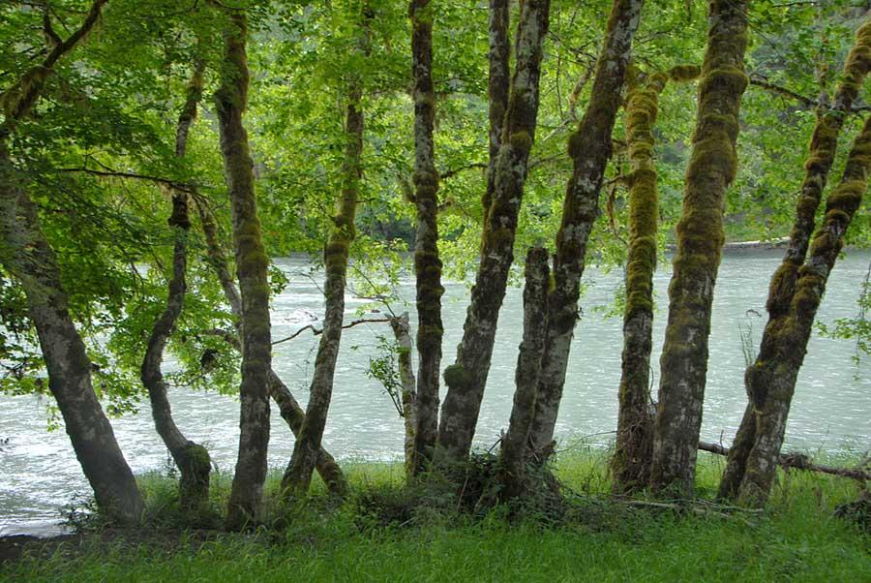
Nitrogen Cycle
Some plants that grow in poor soils feed sugar to specialized bacteria on their roots in exchange for nitrogen fertilizer.
Red Alder Trees in Oregon
Root Nodules harboring Nitrogen-Fixing Bacteria

Slide 13
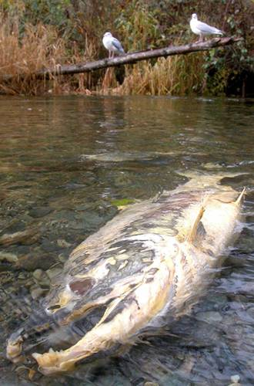
Cycling of Matter
Salmon deliver valuable Nitrogen and Phosphorus from the Pacific Ocean to nutrient-poor Northwest streams and rivers with their carcasses.
Up to 70% of Nitrogen in some of Oregon’s riparian forests originated in the Pacific Ocean!

Slide 14
Ecology Lecture 3
Population
a group of organisms of the same species that live in a specific geographical area
Carrying capacity
the population that an ecosystem can support over time

Slide 15
Populations
Chinook Salmon live four years and produce about 5,000 eggs per female.
If two adult salmon return to spawn in the gravel four years later, the population remains stable.
Salmon are adapted to the volatile, volcanic Northwest (lots of eggs) but also nurture their young in three important ways.

Slide 16
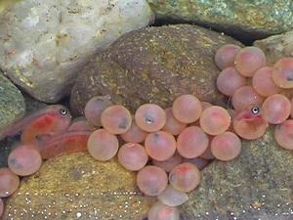
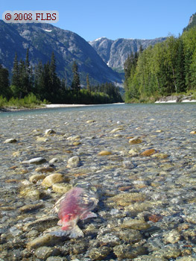
Populations
Salmon travel hundreds of miles from the ocean to lay their eggs in streams far from ocean predators.
Salmon bury their eggs safely under the gravel in redds.
Salmon leave their N & P rich carcasses to feed insects for their fry to eat in the Spring.

Slide 17
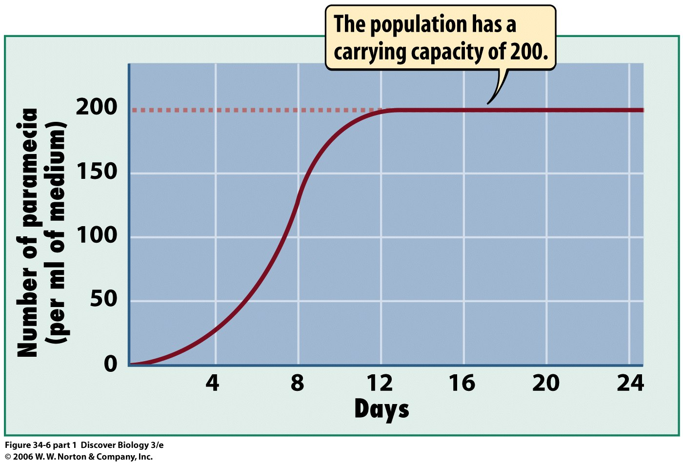
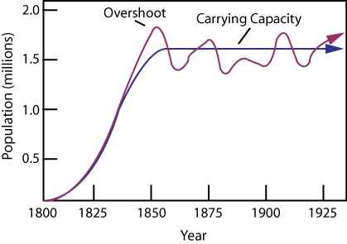
Carrying Capacity
What kind of population graph would salmon have?
Are they that simple? Explain.
k r

Slide 18
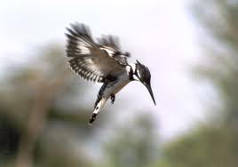
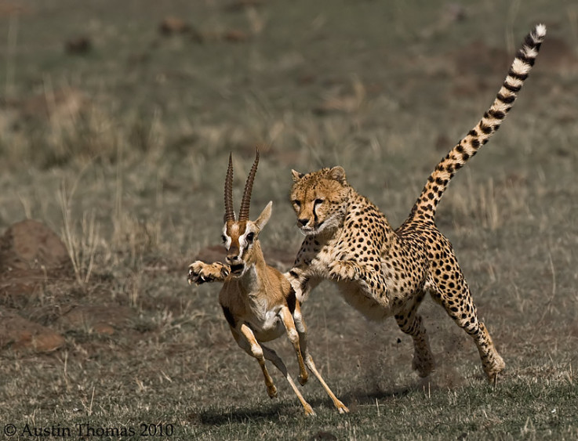
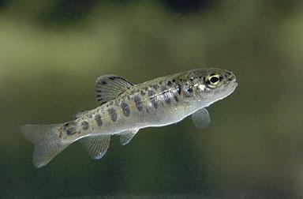
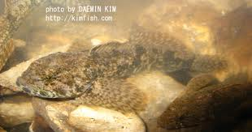
Interactions in Communities

Slide 19
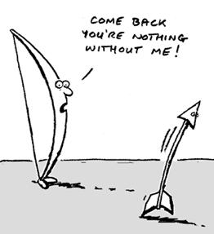
Interactions in Communities
Symbiosis
a relationship in which
two different species
live in close
association.
There are 3 types.

Slide 20
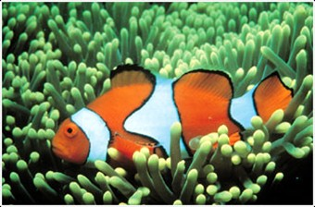
Symbiosis
1. Mutualism
a relationship where both species benefit from the relationship.
Clown fish and sea anemones

Slide 21
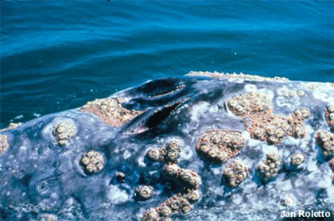
Symbiosis
2. Commensalism
a relationship where one species obtains food or shelter from the other species. Does not harm or help the other species.
Barnacles on whales or crabs

Slide 22
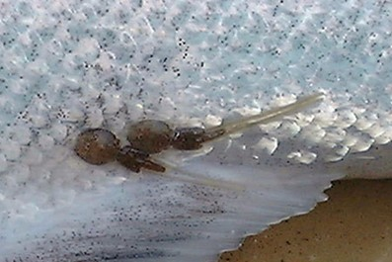
Symbiosis
3. Parasitism
a relationship between two species in which one species benefits while the other species is harmed
Sea lice on salmon

Slide 23
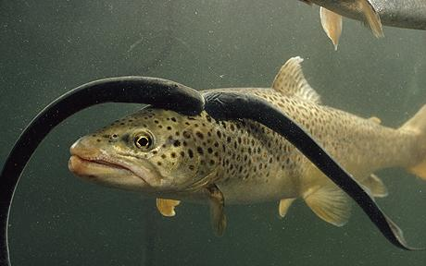
Interactions in Communities

Slide 24
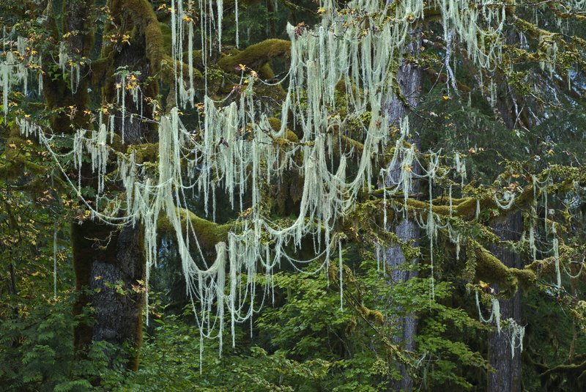
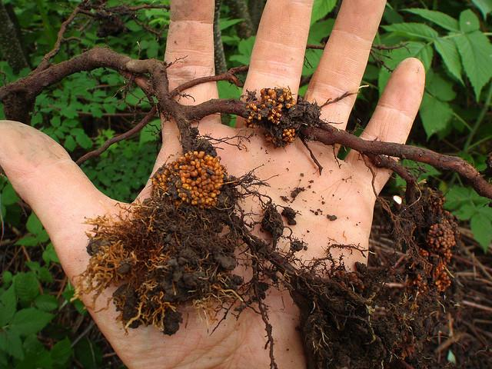
Interactions in Communities
Lichens on a Bigleaf Maple (Mutualism or Commensalism?)
Alder Trees and Symbiotic Bacteria Nodules (Mutualism)

Slide 25
Interactions in Communities
Keystone species
a species that is critical to the functioning of the ecosystem because it affects the survival of so many other species

